Slide 1
Blogs images

Slide 2
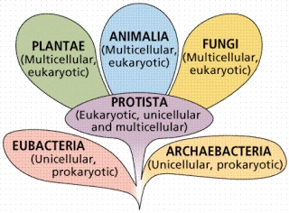
https://lagccnsdoer.commons.gc.cuny.edu/files/2021/02/kingdom-of-life.gif

Slide 3
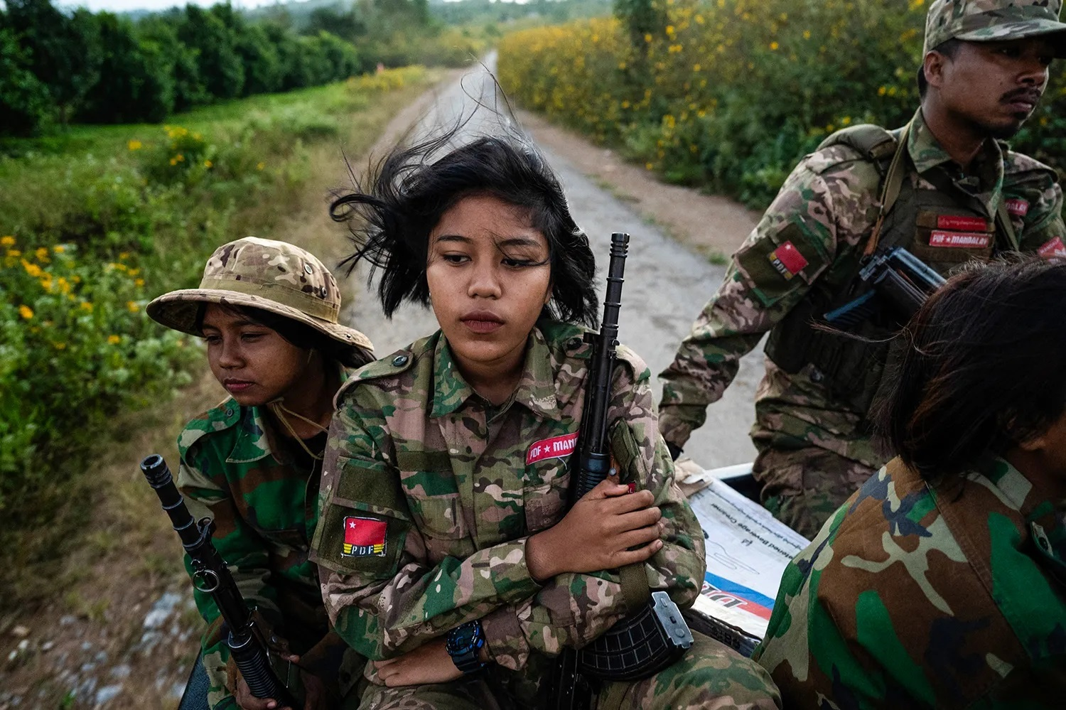
https://foreignpolicy.com/2024/01/02/threats-wars-risk-2024-guyana-belarus-myanmar-abkhazia-ochamchire-cameroon-biya-arctic-nato-pakistan-ttp-ireland/
Retrieved Mar. 15, 2024, from https://foreignpolicy.com/2024/01/02/threats-wars-risk-2024-guyana-belarus-myanmar-abkhazia-ochamchire-cameroon-biya-arctic-nato-pakistan-ttp-ireland/

